Slide 2
Decoding Cryptocurrency Valuation Issues in Insolvency Proceedings
and the Use of AI in Expert Testimony
Moderator: Liam Faulkner, Campbells LLP (Cayman and BVI)
Panelists: Joel Cohen, Stout (New York)
Vince Lazar, Jenner & Block (Chicago)
Stacy Lutkus, McDermott Will & Emery (New York)
Natasha MacParland, Davies Ward Phillips & Vineberg (Toronto)

Slide 3
Crypto Crash of 2022
9 May 2022: Luna token, and its sister coin TerraUSD, collapses losing 99% of its value in 48 hours. A sell off of all cryptocurrencies ensues, with an estimated $400bn of value being wiped. Terraform Labs (Singapore) files for Chapter 11 in Baltimore in January 2024.
27 June 2022: Three Arrows Capital (3AC), a crypto hedge fund, wound up by the BVI Court.
5 July 2022: Voyager Digital, a crypto lender and broker, filed for Chapter 11 protection in the SDNY.
13 July 2022: Celsius Network LLC, a crypto lending and custody platform, filed for Chapter 11 in the SDNY. Chapter 11 Plan of Reorganization approved and confirmed on 9 November 2023.
11 November 2022: FTX, a Bahamas based crypto exchange, filed for Chapter 11 in Delaware. $8bn hole in the accounts.
28 November 2022: BlockFi Inc., a crypto lending platform filed for Chapter 11 in New Jersey.
19 January 2023: Genesis Global, a crypto lender and broker filed for Chapter 11 in the SDNY.

Slide 4
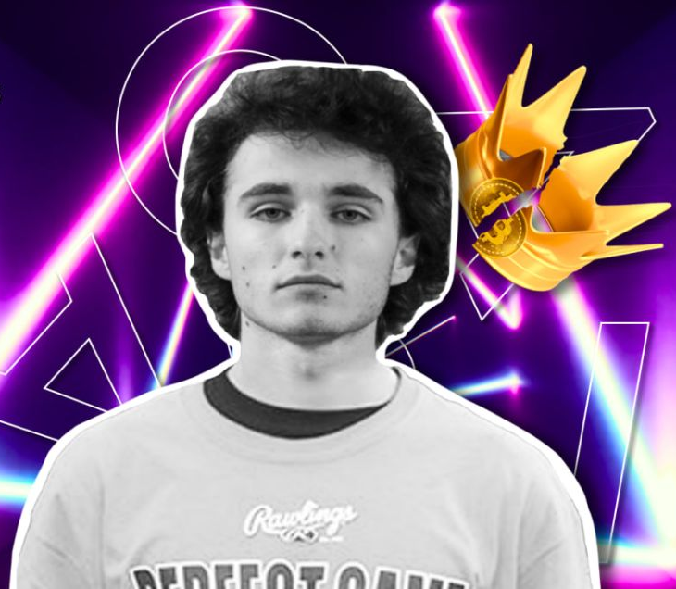
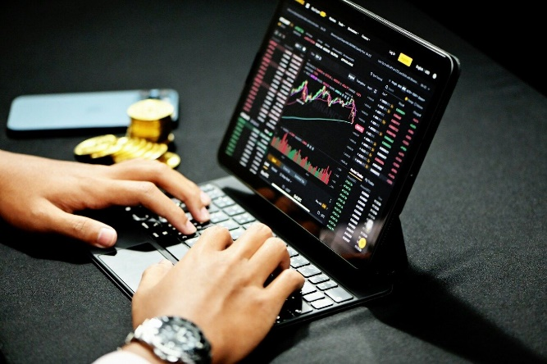
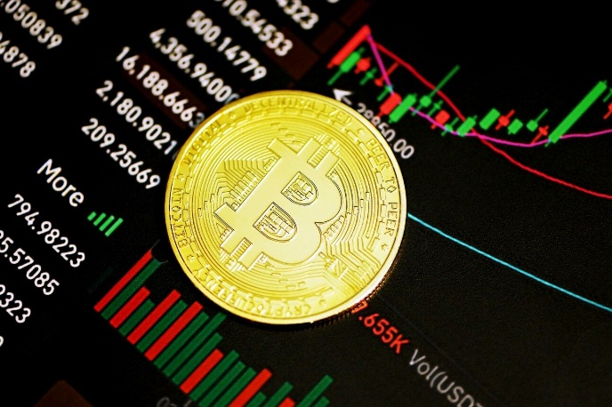
Overview – Canadian Proceedings
No substantive body of law in Canada, as there haven’t been many filings
Most filings are fraud-related
MtGox (Recognition
Proceeding)
(2014)
QuadrigaCX
(2019)
Einstein
Exchange
(2019)
Aiden Pleterski and
AP Private Equity Limited
(2022)
IE CA 3 Holdings Limited
and IE CA 4
Holdings Limited
(2023)
CatalX CTS Ltd.
and Catalx Management Ltd. (2024)

Slide 5
Inherent value of crypto?
Judge Dorsey of Delaware Bankruptcy Court in Re FTX:
“Unlike corporate stock, which is backed by hard assets held by the company, or fiat currency that is backed by the issuing government entity, cryptocurrencies are only worth what someone is willing to pay for them on any given day. They trade solely on sentiment, similar to artwork or baseball cards. That is, someone purchases a coin or a token because the buyer believes it will increase in value over time. When the buyer believes the coin or token will decrease in value, it is sold. There is, therefore, no underlying value to help inform the market value of these assets.”

Slide 6
Lack of reliable data
Judge Dorsey of Delaware Bankruptcy Court in Re FTX:
“Over 20,000 different types of cryptocurrencies have been created in the last ten years. Unlike standard equity trading, which occurs across only a handful of heavily regulated exchanges, cryptocurrencies are traded on more than 1500 exchanges and regulation has been described as somewhere between sparse and non-existent. This raises questions about the reliability and trustworthiness of the sources from which valuation data is obtained.”

Slide 7
Decoding Cryptocurrency Valuation Issues in Insolvency Proceedings
and the Use of AI in Expert Testimony
Moderator: Liam Faulkner, Campbells LLP (Cayman and BVI)
Panelists: Joel Cohen, Stoutt (New York)
Vince Lazar, Jenner & Block (Chicago)
Stacy Lutkus, McDermott Will & Emery (New York)
Natasha MacParland, Davies Ward Phillips & Vineberg (Toronto)

